Slide 1
Central Texas Poverty Patterns
Jacob Cano
Carlos A Soto
Alexander West
An Interactive Web Map

Slide 2
Outline
Background
Data Sources
Target Audience
Problem
Map Components and Demonstration
Contributions and Limitations
Conclusion

Slide 3
Background
The ACS is the primary source of demographic data in the USA.
It consists of a sample of the population, approximately 3.5 million households annually.
The US Census Bureau provides Margin of Error (MOE) at the 90% confidence interval for all estimates.
Research recommends that planners should report corresponding MOEs of ACS estimates, and that web resources for demographic data report corresponding MOE values (Jurjevich et al., 2018).

Slide 4
Data Sources
Poverty:
Table C17002, Ratio of Income to Poverty Level in the Past 12 Months, by Census Tract, 2015-2019 United States Census Bureau American Community Survey (ACS)
(https://data.census.gov/cedsci/table?q=c17002&g=0500000US48021%241400000,48055%241400000,48209%241400000,48453%241400000,48491%241400000&tid=ACSDT5Y2019.C17002&hidePreview=true )
Austin Travis County Health and Human Services (HHS) Provider Locations:
Austin Open Data Portal
https://data.austintexas.gov/Locations-and-Maps/Health-and-Human-Services-Locations/t7pf-7p2m

Slide 5
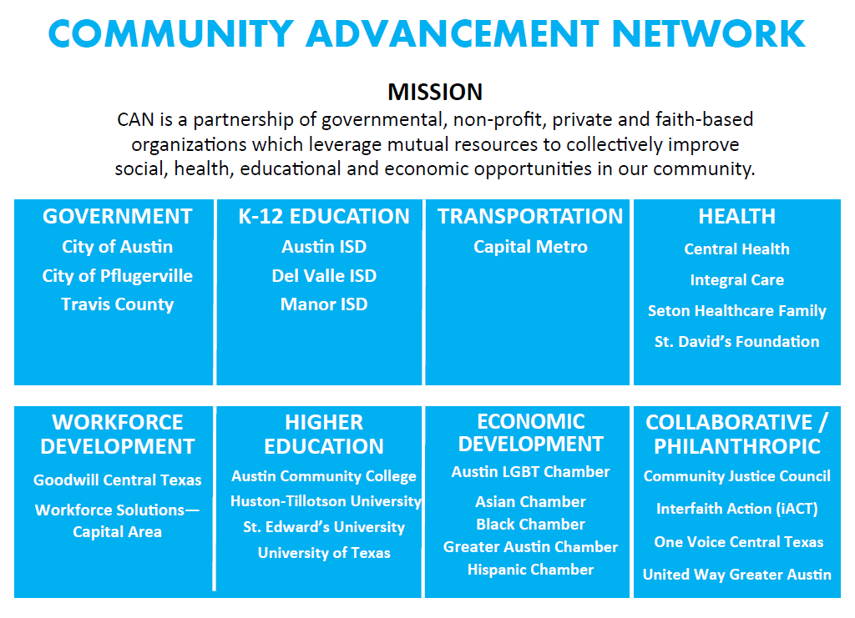
Target Audience
Researchers and planners from the Community Advancement Network
Others who may be interested

Slide 6
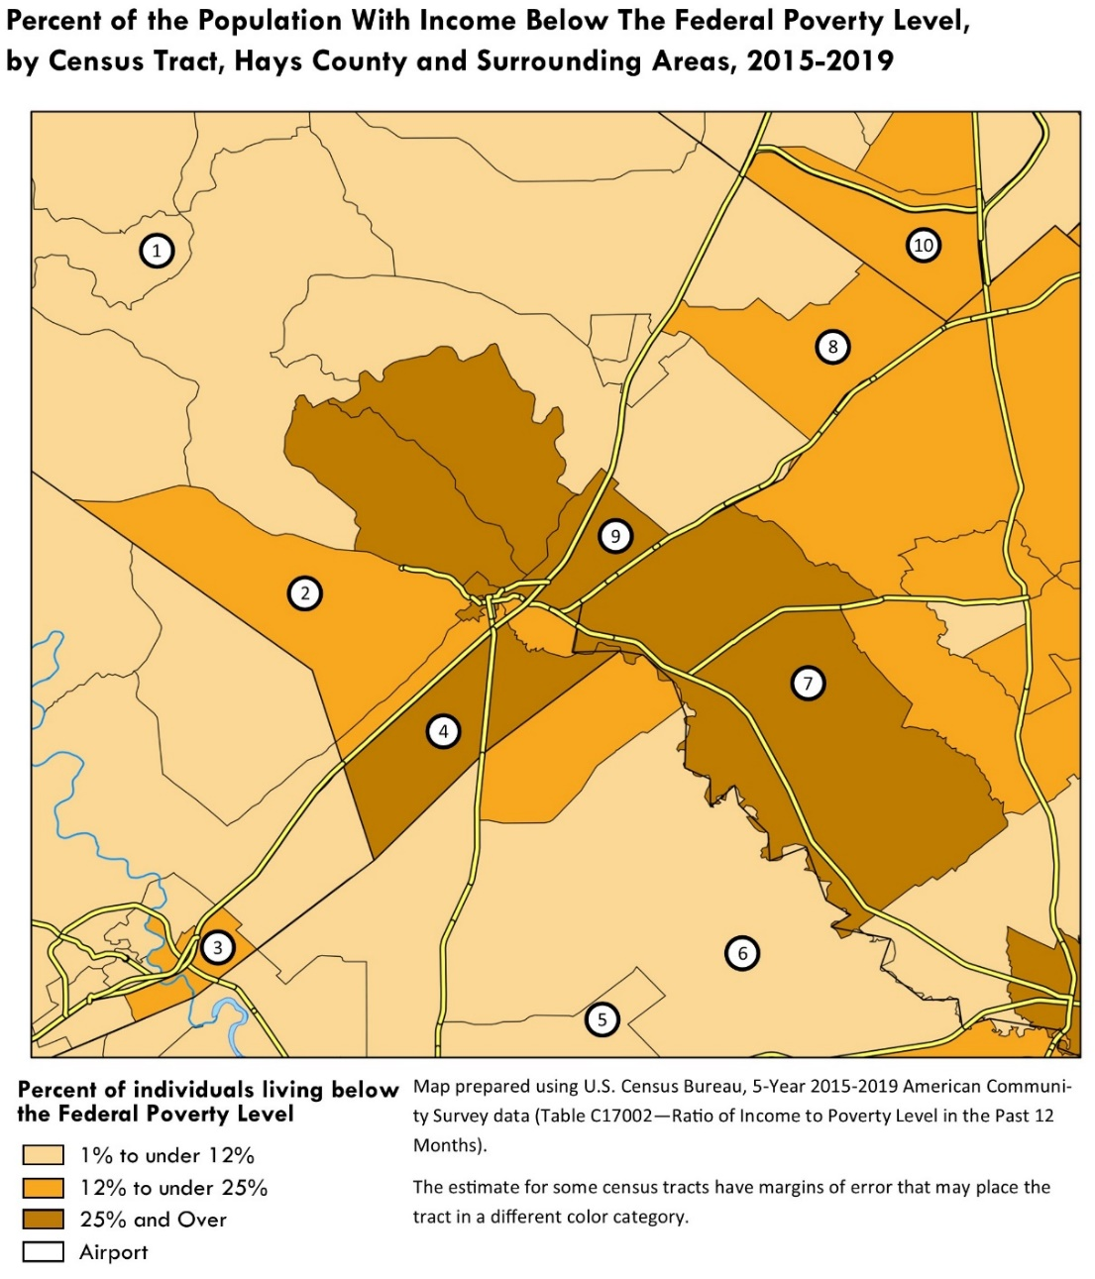
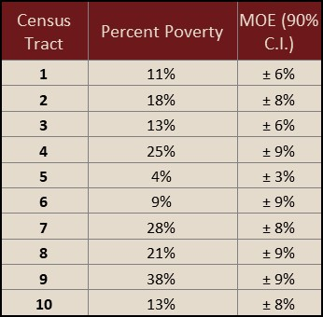
Problem

Slide 7
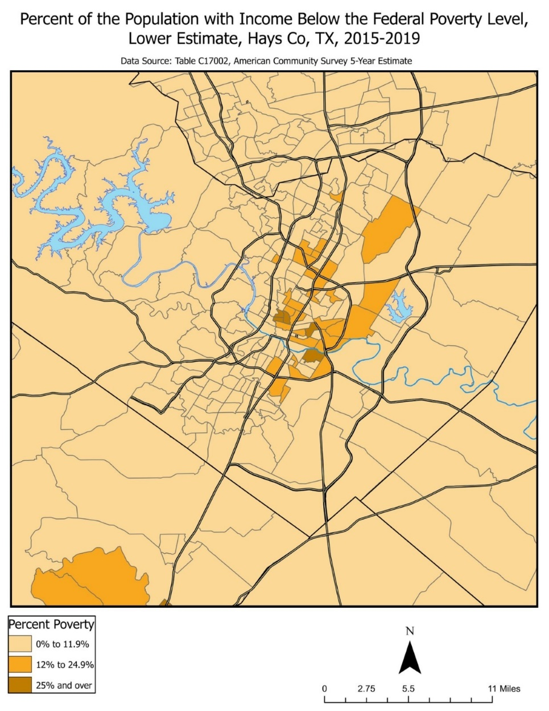
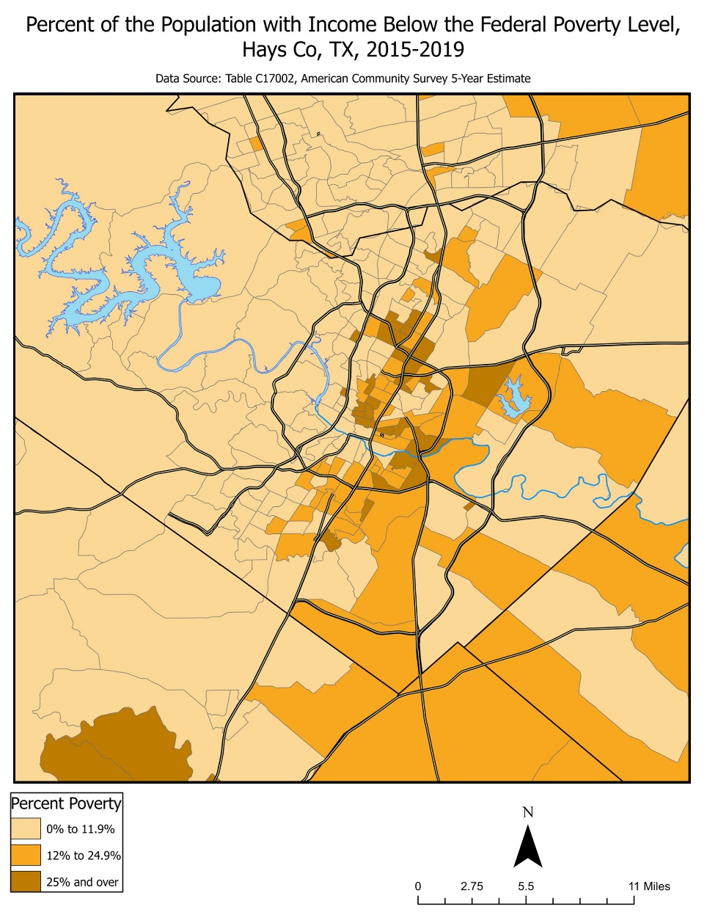
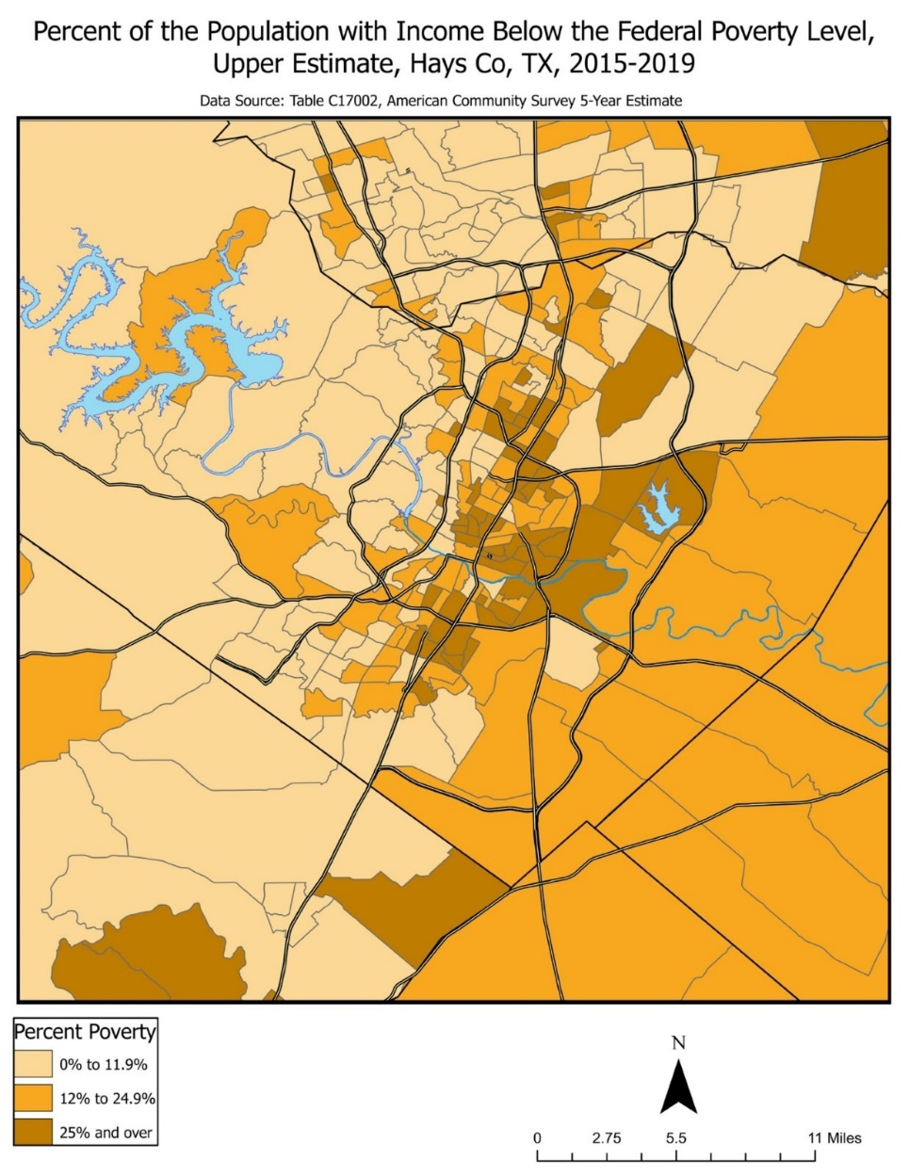
Lower Estimate
Estimate
Upper Estimate

Slide 8
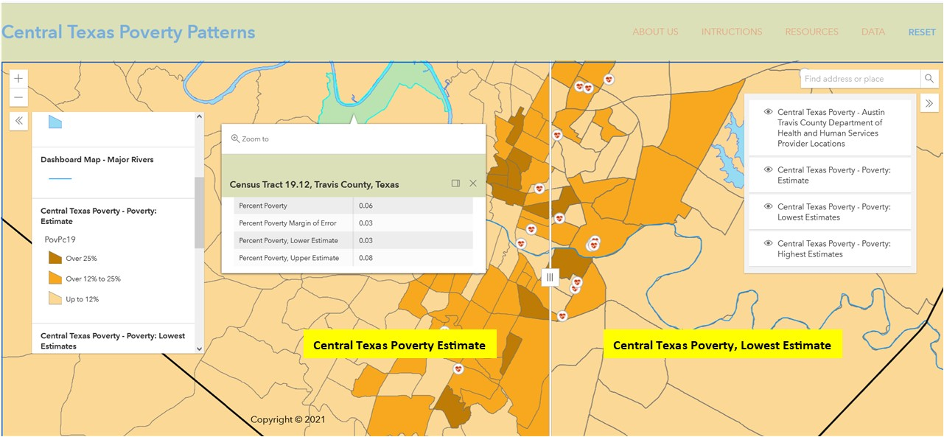
Map Components
Search Query
Collapsible Legend
Collapsible LayerList with visibility selection
Swipe Widget

Slide 9
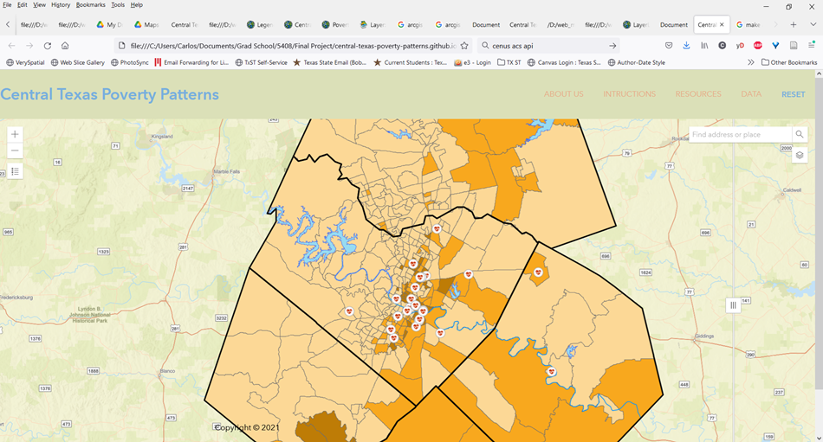
Web Map Demonstration

Slide 10
Contributions and Limitations
Our application maps the upper and lower estimates within the MOE along with the estimate for each census tract.
This leverages interactivity and the human eye’s capacity to detect change.
The result is an intuitive, easy to use tool that helps highlight what geographic patterns may be misleading due to unreliable data
Potential limitations of this web mapping application include technical and user constraints.
Our application shows the upper and lower estimates, but the actual value for that census tract may be within those two extremes
People who lack an understanding of statistical uncertainty and margin of error may misunderstand what is represented in the map

Slide 11
Conclusion
Main component remained relatively unchanged from proposal
Secondary component had to be changed due to unavailability of timely data at the desired geographic level
Suggestions for future work are to connect the mapping application to the US Census Bureau’s ACS API to dynamically generate the estimated poverty layer and it’s corresponding upper and lower estimate layers
Doing so would extend the tool’s utility to anywhere there is data available.

Slide 12
References
Jurjevich, J. R., Griffin, A. L., Spielman, S. E., Folch, D. C., Merrick, M., & Nagle, N. N. (2018). Navigating Statistical Uncertainty: How Urban and Regional Planners Understand and Work With American Community Survey (ACS) Data for Guiding Policy. Journal of the American Planning Association, 84(2), 112–126. https://doi.org/10.1080/01944363.2018.1440182

